Slide 1
Keywords
Constants(integer, real, character, string) Literals
Variables

Slide 2
Keywords
These are some reserved words in C which have predefined meaning to compiler called keywords.
Keywords are not to be used as variable and constant names.
All keywords have fixed meanings and these meanings cannot be changed.

Slide 3
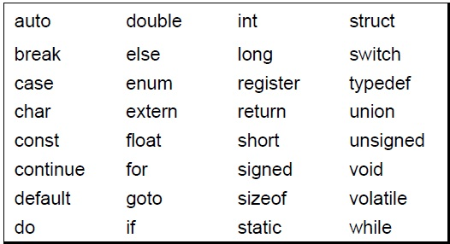
Compiler specific keywords (32)
Some commonly used keywords are given below:

Slide 4
Constants
Constants are data values that cannot be changed during the execution of a program. Like variables, constants have a type. In this section, we discuss Boolean, character, integer, real, complex, and string constants.
Topics discussed in this section:
Constant Representation
Coding Constants

Slide 5
Note
A character constant is enclosed in single quotes.
Use single quotes for character constants.
Use double quotes for string constants.

Slide 6
Examples of Constant
Constant | Example
Decimal Constant | 10, 20, 450 etc.
Real or Floating-point Constant | 10.3, 20.2, 450.6 etc.
Octal Constant | 021, 033, 046 etc.
Hexadecimal Constant | 0x2a, 0x7b, 0xaa etc.
Character Constant | 'a', 'b', 'x' etc.
String Constant | "c", "c program", "c in javatpoint" etc.

Slide 7
Examples of Integer Constants

Slide 8
Examples of Real Constants

Slide 9
Examples of String Constants

Slide 10
Null Characters and Null Strings?
Characters and Strings its definitions are defined, but \0 is an explicit
representation where as in “” is an implicit representation?

Slide 11
Symbolic Names for Control Characters

Slide 12
Two ways to define constant
const keyword
#define preprocessor

Slide 13
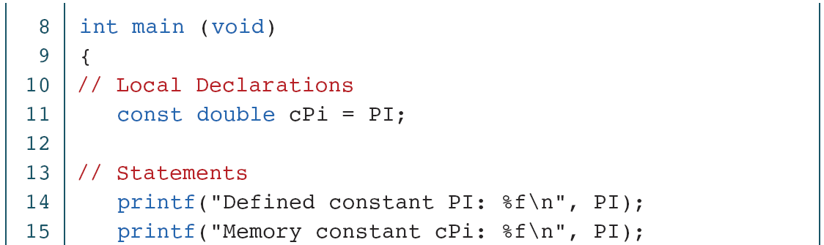
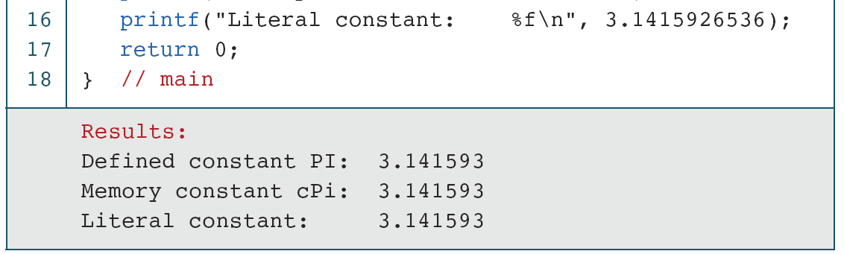
EXAMPLE PROGRAM

Slide 14
Literals
Literals are the constant values assigned to the constant variables. We can say that the literals represent the fixed values that cannot be modified.
For example, const int =10; is a constant integer expression in which 10 is an integer literal.
There are four types of literals that exist in C programming:
Integer literal
Float literal
Character literal
String literal

Slide 15
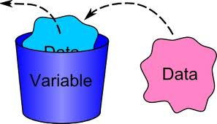
Variables
A variable is a container (storage area) to hold data
Variables are data storage locations in the computer’s memory.
To indicate the storage area, each variable should be given a unique name (identifier).
Example: float f=20.8; Here, f is variable

Slide 16
Variables
Variables are the symbolic names for storing computational data.
Variable: a symbolic name for a memory location
In C variables have to be declared before they are used Ex: int x;
A variable may take different values at different times during execution.
Declarations reserve storage for the variable.
Value is assigned to the variable by initialization or assignment

Slide 17
Variable declarations
Data type Variable name;
Which data types
are possible in C ?
Which variable names
are allowed in C ?

Slide 18
Variable Names- Identifiers
Symbolic names can be used in C for various data items used by a programmer.
A symbolic name is generally known as an identifier. An identifier is a name for a variable, constant, function, etc.
The identifier is a sequence of characters taken from C character set.

Slide 19
Variable names
Rules for valid variable names (identifiers) :
Name must begin with a letter or underscore ( _ ) and can be followed by any combination of letters, underscores, or digits.
Key words cannot be used as a variable name.
C is case-sensitive: sum, Sum, and SUM each refer to a different variable.
Variable names can be as long as you want, although only the first 63 (or 31) characters might be significant.
Choice of meaningful variable names can increase the readability of a program
Examples:
  Sum
  _difference
  a
  J5x7
  Number_of_moves
  3val
  int

Slide 20
Declaring variables
C imposes to declare variables before their usage.
Advantages of variable declarations:
Putting all the variables in one place makes it easier for a reader to understand the program.
Thinking about which variables to declare encourages the programmer to do some planning before writing a program.
The obligation to declare all variables helps prevent bugs of misspelled variable names.
Compiler knows the amount of memory needed for storing the variable.
Compiler can verify that operations done on a variable are allowed by its type.

Slide 21
Using and Displaying Variables
#include <stdio.h>
int main ()
{
int sum;
sum = 50 + 25;
printf("The sum of 50 and 25 is%d”,sum);
return 0;
}
Variable sum declared of type int
Variable sum assigned expression 50+25
Value of variable sum is printed

Slide 22
Variables - Examples
int a; // declaring a variable of type int
int sum, a1, a2; // declaring 3 variables
int x = 7; // declaring and initializing a variable
a = 5; // assigning to variable a the value 5
a1 = a; // assigning to variable a1 the value of a
L-value
R-value
a1=a1+1; // assigning to variable a1 the value of a1+1
// (increasing value of a1 with 1)

Slide 23
